Slide 1

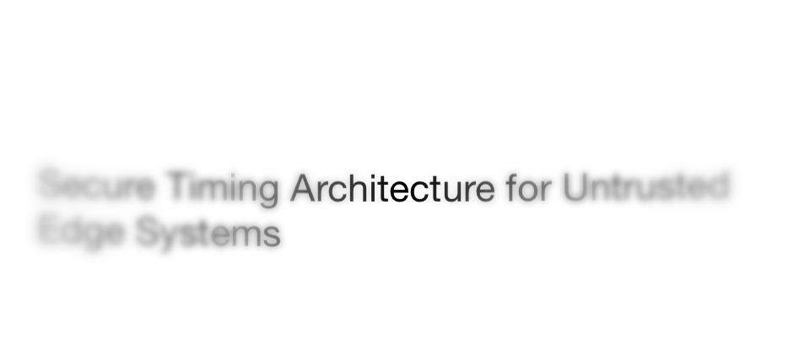
Secure Timing Architecture for Untrusted Edge Systems
MIRONOV VYACHESLAV fanwar@umass.edu
In collaboration with my PhD advisee, Adeel Nasrullah

Slide 2
An Edge Platform
Application
Information flow
Operating System
Information flow
Hardware
2

Slide 3




Networked Edge System
Application
OS
Hardware
Cloud
Multi Tier
Network Fabric
Application
Edge
OS
Multi Modal
Hardware
Physical World

Slide 4

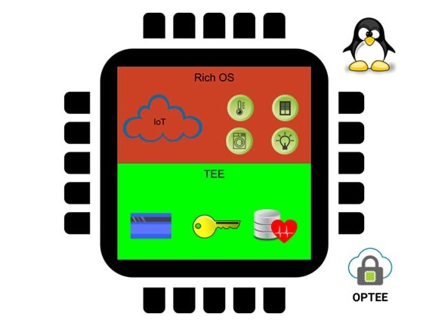




Untrusted Edge System
Machine Learning
Database
Cloud
Multi Tier and Delay prone
Network Vulnerabilities
Edge
Environmental Sensors
AR/VR
Headsets
Multi Modal and Diverse
Drone
Physical World

Slide 5
Vulnerabilities in Time
Causes
Malicious delays
Inconsistent rates
Induced drifts
Consequence
Time discontinuities, Fuzzy Time
5

Slide 6
Attack Strategies
Absolute Reference time
Time Source 1
No Attack
6

Slide 7

Attack Strategies (1)
Fuzzy Time
Absolute Reference time
Jump Time Arbitrarily
Time Source 1
Offset Manipulation
7

Slide 8
Attack Strategies (2)
Effect on a Single Time Source:
Error Accumulation over time
Absolute Reference time
Increase Time Advance Rate
Time Source 1
Rate Manipulation
8

Slide 9
Attack Strategies (2)
Relative Effect on Two Time Sources:
error = 0
error = 2 error = 4
Absolute Reference time
Decrease Time Advance Rate
Time Source 1
Increase Time Advance Rate
Time Source 2
Rate Manipulation
9

Slide 10


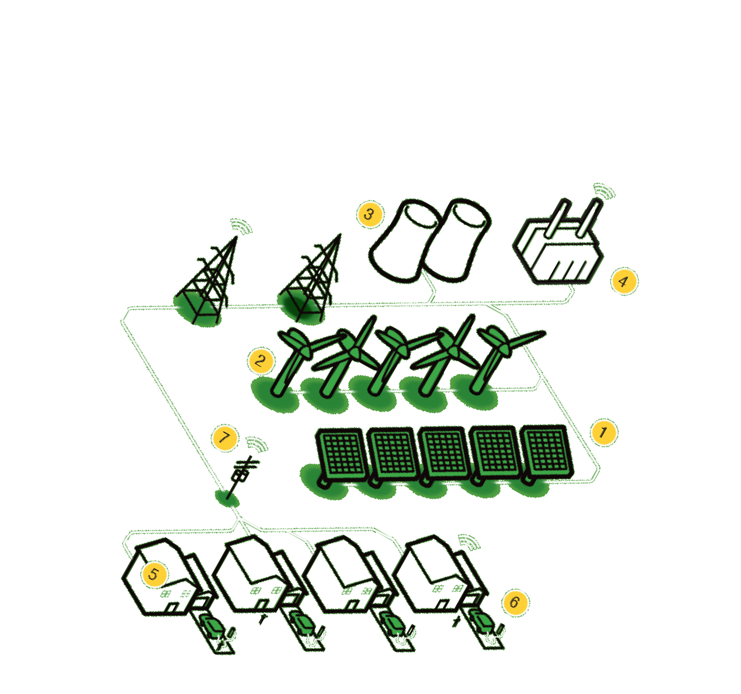


Time Attack Consequences
Forge Timestamp
Location theft
Grid Attack
Activity Misclassification
10

Slide 11
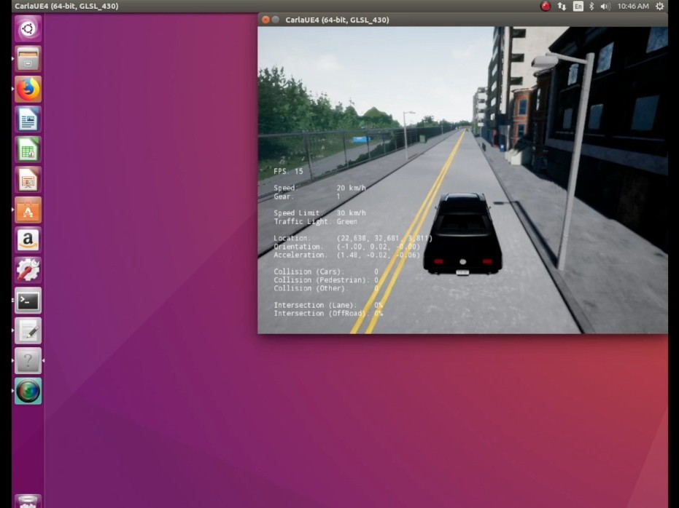
CARLA Simulator
Network Time Attack
11

Slide 12
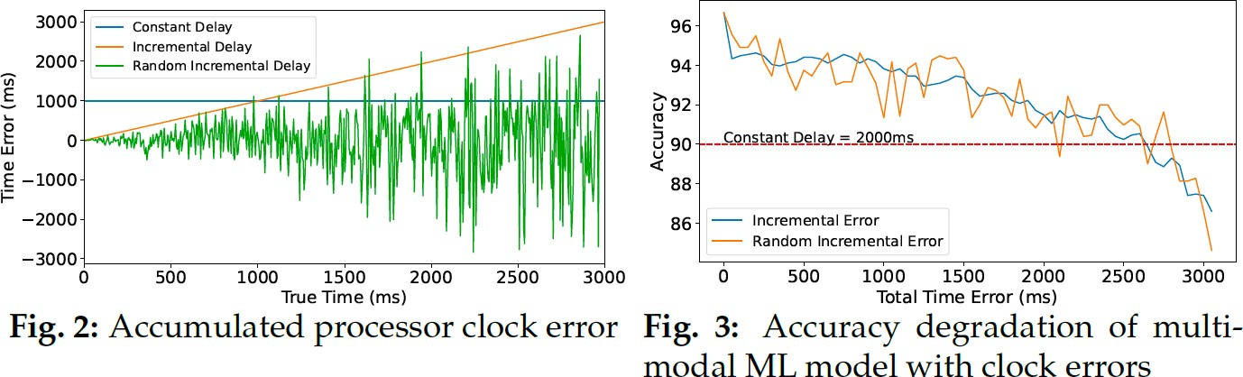
Attack on ARM Trustzone “Trusted” Time
12

Slide 13
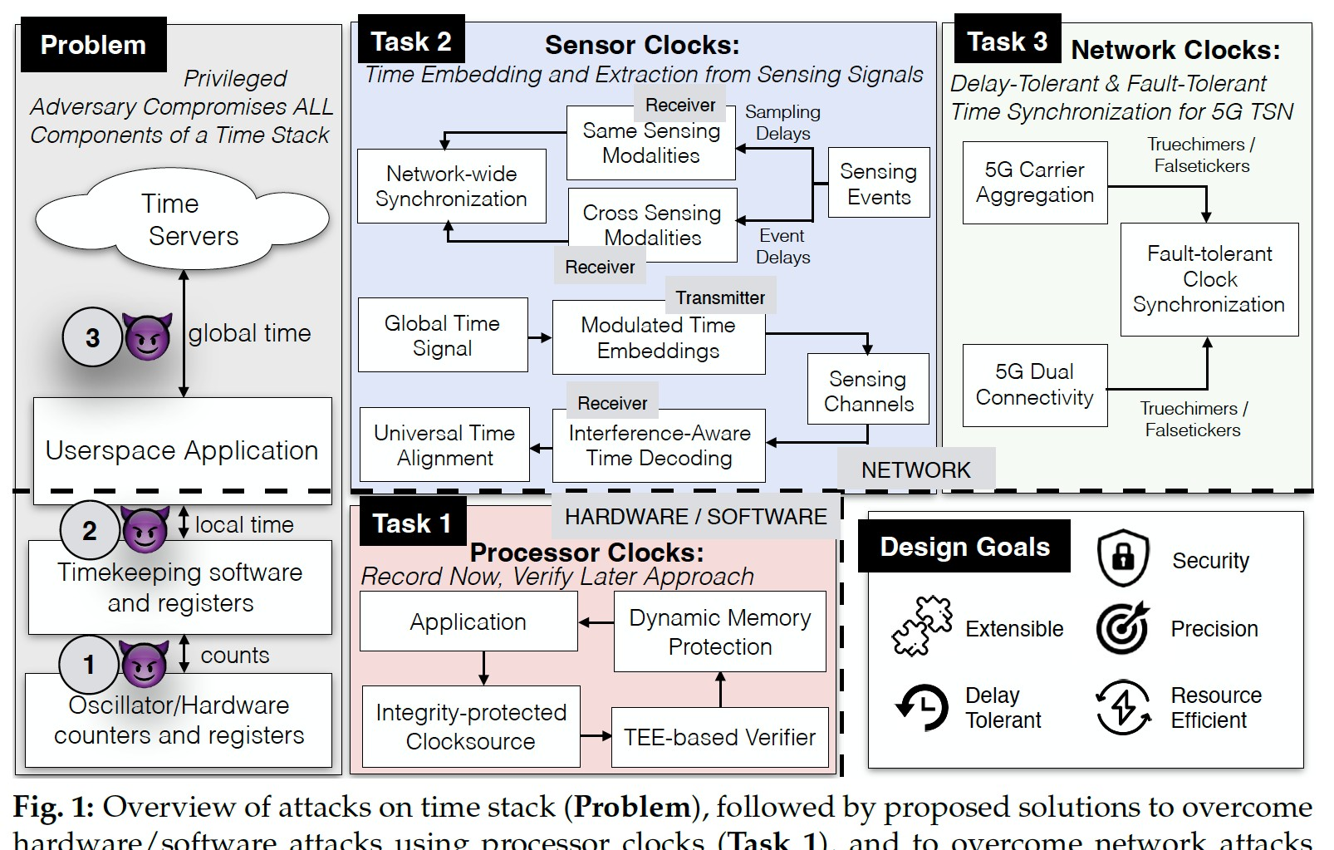

Problem and Proposed Approach
1
3

Slide 14
Time Transfer for Heterogeneous Devices with Sensor Clocks
Goal:
Make a case for sensing channels to securely transfer time across heterogeneous Commercial Off The Shelf (COTS) devices at a low bandwidth and compute cost
Explore alternative signals to traditional networking packets, and alternative channels for time synchronization

Slide 15
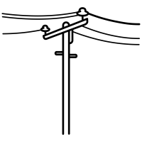
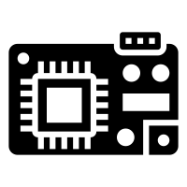
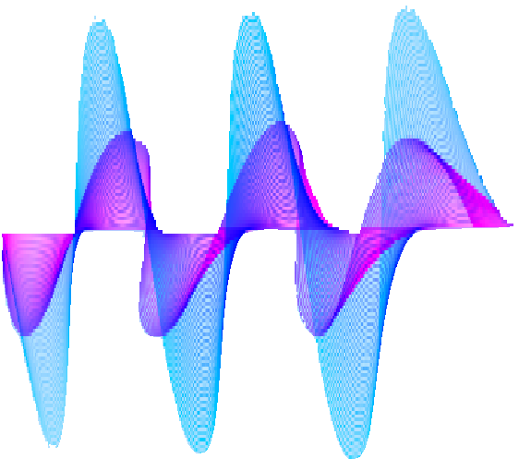



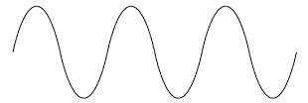






Sensing for Synchronization - Prior Work
State of the art work
Electromagnetic Waves
Voltage
t
16.67 ms
Fluorescent Light
Light Intensity
8.33 ms
t
No Packet Exchange
Support multiple Radios
Low Power Consumption

Slide 16




Sensing for Synchronization — Limitations
Customized Hardware
Electromagnetic Waves
Voltage
t
16.67 ms
No support for diverse sensors
Fluorescent Light
Light Intensity
8.33 ms
t
Existing sensing based synchronization lacks support for commodity sensors

Slide 17
Problem Statement
No Custom Hardware Requirements Heterogeneous software, network and radio support
How to build a universal sensing based time synchronization solution for resource constrained commercial off the shelf heterogeneous devices?
Low energy, bandwidth and computational requirements

Slide 18

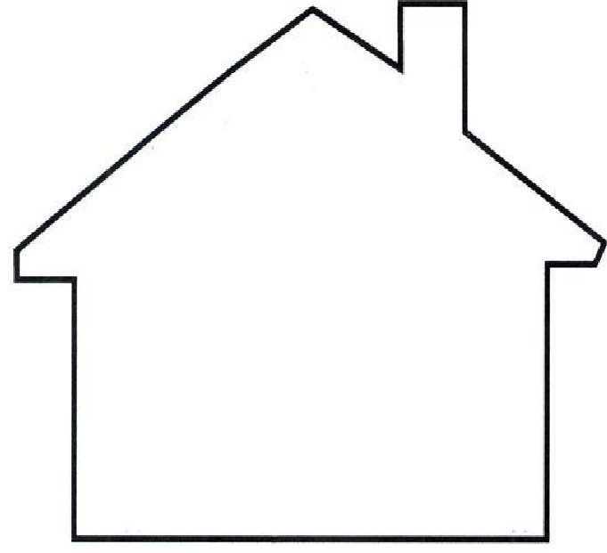
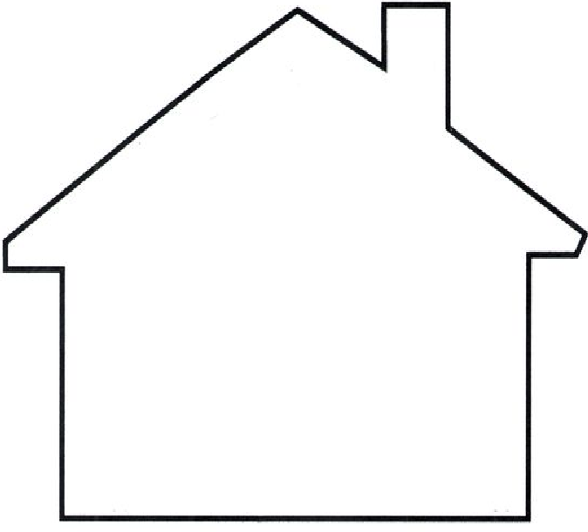



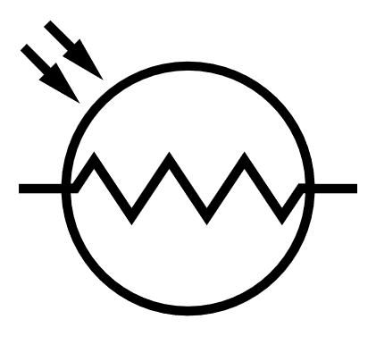

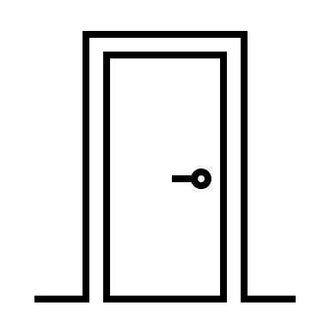









Our Approaches
Optical Sensor
Optical
Sensor
Microphone
Microphone
Audio
Light
Grid ENF Edge Server
IMU
Active Sensing
Passive Sensing

Slide 19
Passive Sensing Approach
Harvesting Ambient Events to Synchronize Time across heterogeneous IoT Devices (HAEST)

Slide 20
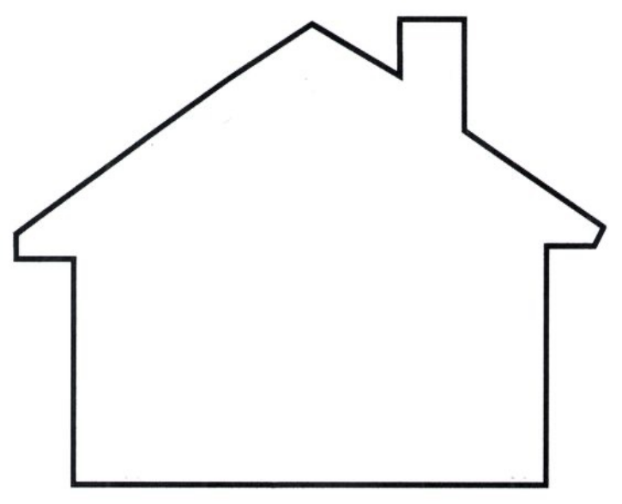





HAEST - Principle Idea
Door Opened
Door Closed
Door Opened
Door Closed
_{t} M
Microphone
_{t} M
A
B
Optic
Device Clocks
al
Sens
_{t} I
_{t} I
or
Microph
A
IMU
B
one
_{t} O
_{t} O
Optical Sensor
B
A
IM U

Slide 21
HAEST - Research Challenges
Event Detection: Lightweight (throughput > 1k samples/sec), Universal (shared algorithm) and Scalable (No Manual Calibration)
Cadence: throughput 33 samples/sec with a dedicated deep learning model
Delay Adjusted Clock Sync: a single event is detected with a delay across sensor pair
Ambient signals travel asymmetric distances towards the pair
Signals may have drastically different propagation speeds
Network-wide Sync: all sensors in a network do not observe events in common

Slide 22
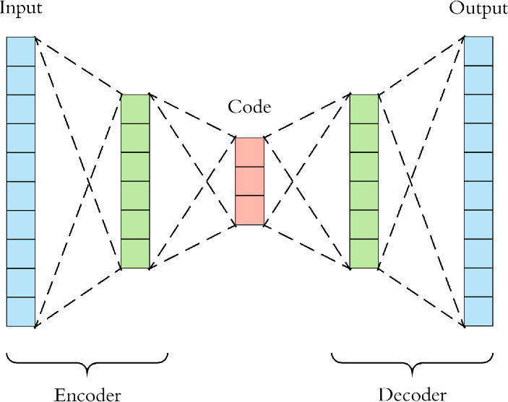



Research Challenge 1
Event Detection — Intuition
Sensor Data Distribution
Auto- encoders
Distance Scores
ensor Data
Encodings
S
Sensor Data

Slide 23
Event Detection
Research Challenge 1
Encoder
Sensor Data Vector
Distance
Local
Calculation
Maxima
Events
Scalable: Auto- encoders training is unsupervised eliminating the need for manual calibrations.

Slide 24

Event Detection — Lightweight
Research Challenge 1
Encoder
Sensor Data
Vector
Distance
Local
Calculation
Maxima
Events
8-bit integer ops
32-bit floating point matrix
Quantization

Slide 25



Event Detection — Universal
Research Challenge 1
Sensor Data
Unified Encoder
Specialized Encoders
Distance Calculation
Local Maxima
S1
S1 Events
S2
S2 Events
Batched Inputs
SN Events
SN

Slide 26
Event Detection — tackling high data rates
Research Challenge 1
Sensor Data
Encoder
Vector
Distance Calculation
Local Maxima
SN
Events
SN
Cascaded
Detection

Slide 27
Event Detection — putting it all together
Research Challenge 1
Sensor Data
Unified
Specialized
Distance
Event Detection
S1
Encoder
Encoders
Calculation
Batched
S1 Events
S2
Inputs
S2 Events
SN Events
Cascaded
SN
S
N
Quantized Models
Detection
SN

Slide 28



Research Challenge 2
Delay Adjusted Clock Sync
1 meter
3 meter
Optical Sensor Delay:
Audio Sensor Delay:
1 meter
d_{o} =
3 meter
d_{o} =
3 x 10⁸ meter/second
340 meter/second

Slide 29





Research Challenge 2
Delay Adjusted Clock Sync
vs
n
k
d(bin_{i}) dt
offset = ¹
_{n} Z
bin⁰
drift =
i
Z
i=1
i=1

Slide 30
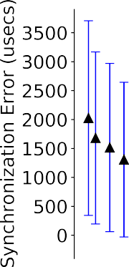
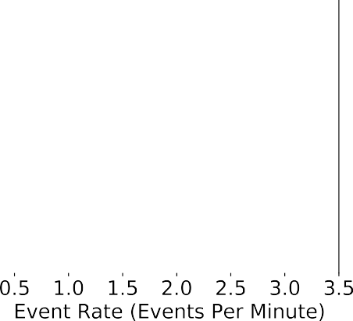
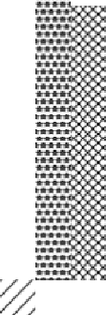
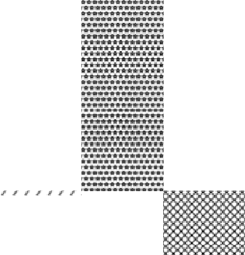
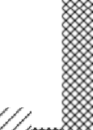
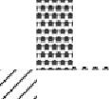
Research Challenge 2
Delay Adjusted Clock Sync
Key Result Higher sampling frequency yields better clock estimates
Key Result Inverse relationship between event occurrence rate and clock error
Key Result Some sensor types on a platform out perform the others

Slide 31
Research Challenge 3
Network-wide Synchronization
Markov Clustering Algorithm
for node :
for edge :
delete i f edge! = max( freq)
for node :
for edge :
delete i f edge! = max(events)
31

Slide 32
Overall HAEST Design
Base Encoder Model
Network Sync
Bootstrapping Phase
 |  | s
En | Train Sensor coder
Inference
Data Collection
Mutual Event Count
Sensor Network: Sync Pairs
Sensor
Event Detection
Data Streaming
Synchronization Phase
Clock Pair Sync
Detected Mutual Events
Clock Parameter Estimation
Sensor
Base
Encoder Model
Base
Encoder Model
Base
Encoder Model
Base
Encoder Model
Base
Encoder Model
Encoder
Inference
IoT Devices
Gateway
32

Slide 33
Evaluations
Heterogeneous commodity devices
ESP32 Things: 32-bit dual Core, WiFi/BLE enabled, hardware time- stamping, RTOS
STK 2650: 32-bit single Core, BLE enabled, software time-stamping, RTOS
FLORA: 8-bit single core, Serial Communication, software time-stamping
Heterogeneous commodity sensors
IMU, optical and audio
Event detection results using data-sets: UCI HAPT (IMU) and DCASE 2016 (Audio)
Clock parameter estimation: characterization of frequency, sampling rate and
sensor type affects on clock drift
Case Studies: Smart Home and WBAN study to evaluate network wide synchronization performance
Performance comparison with NTP
33

Slide 34
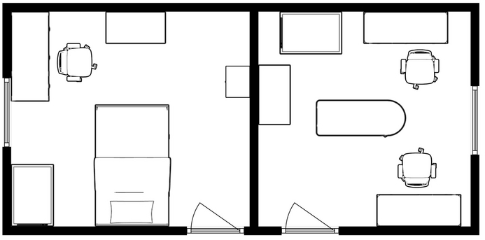
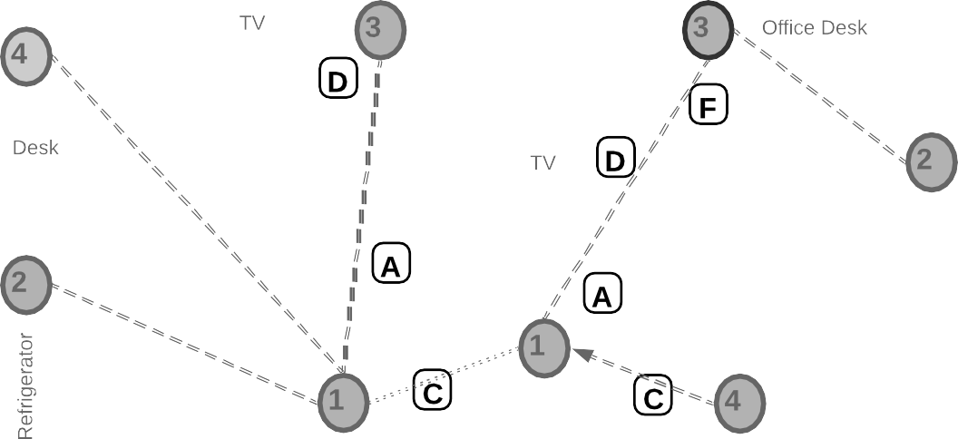



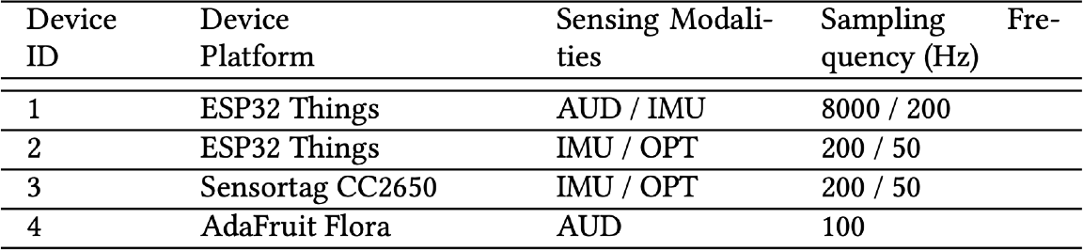
Case Study: Smart Home
34

Slide 35
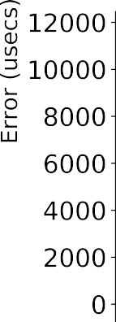
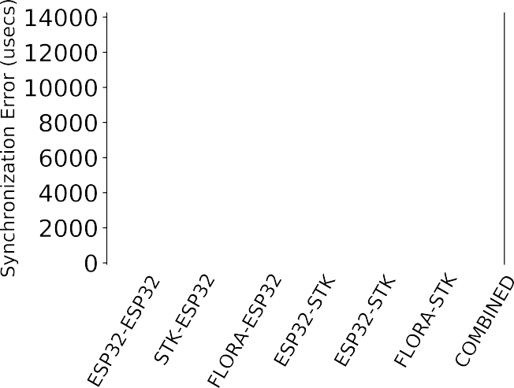
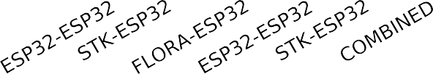
Case Study: Results
Intra-cluster sync error
Inter-cluster sync error
Key Result
We achieve an average error of few milliseconds and best case error is under a millisecond.
Key Result
On average inter-cluster sync errors are greater than intra-cluster errors.
35

Slide 36
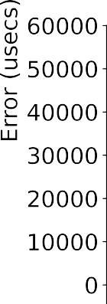
NTP Comparison
NTP over Serial Connection
NTP over BLE Connection
NTP consumes upto 36% more power.
Key Result
We achieve better mean error and spread than NTP over both the serial and BLE connection while consuming less power.
36

Slide 37
Problem and Proposed Approach
3
7

Slide 38





Questions

